Slide 1
Initial Assessment in Maths - from Basic Entry Level Numeracy to Higher Level Maths in Functional Skill
You must show the necessary and possible Working steps to justify your answers or solutions, please in all problems !
Sample Solutions
by Anwar Faruqh

Slide 2
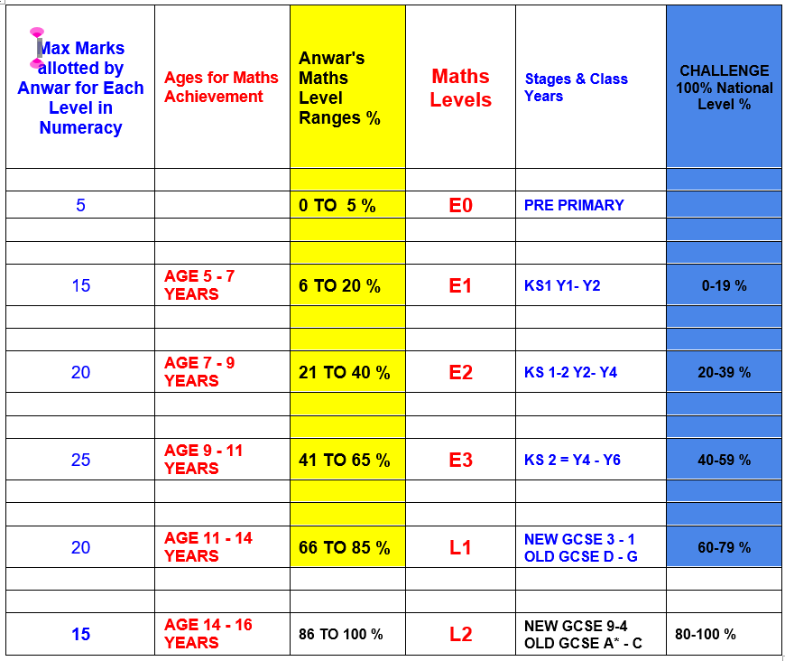

Slide 3
MS
Q.1

Slide 4
MS
A.1
The elephant is big.
The mouse is small.

Slide 5
Q. 2

Slide 6
A. 2
The snake is long.
The pencil is short.

Slide 7
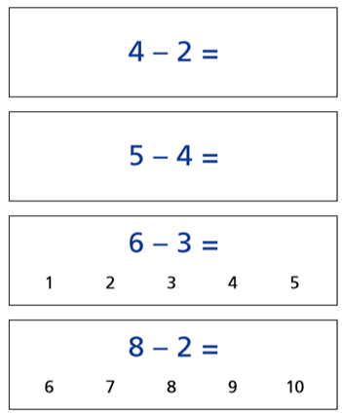
Q.3

Slide 8
4 - 2 = 2
5 - 4 = 1
6 - 3 = 3
8 - 2 = 6
A.3

Slide 9
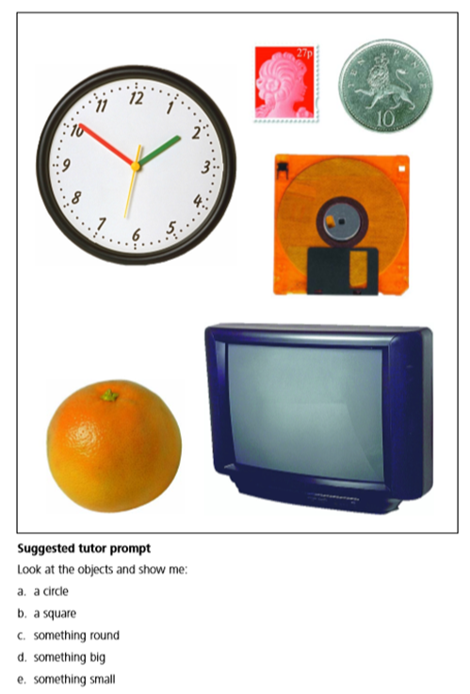
Q. 4

Slide 10
Circle
e. Something small.
A. 4
b. Square
La silla
Circle
d. Something big
c. Something round

Slide 11
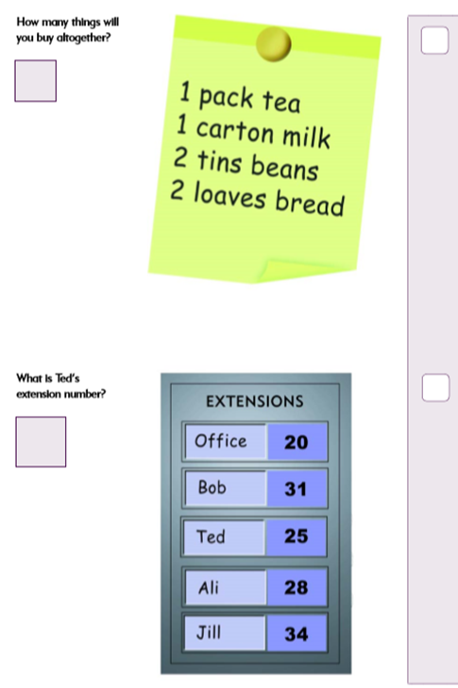
E 1
Q.5

Slide 12
E 1
A.5
I will buy 1+1+2+2 = 6 things altogether.
Ted’s extension number is 25

Slide 13
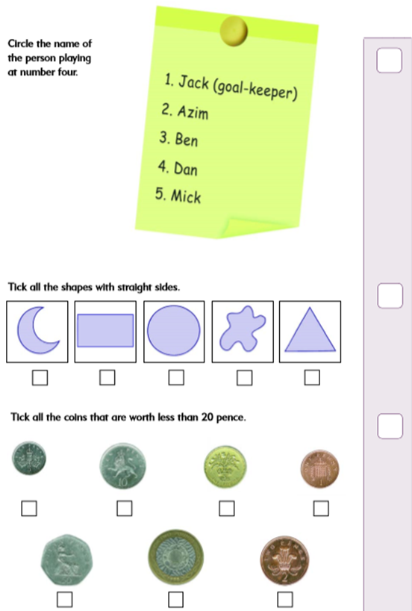
Q.6
1 p
5p
10 p
2 p

Slide 14
A.6
1 p
5p
10 p
2 p

Slide 15
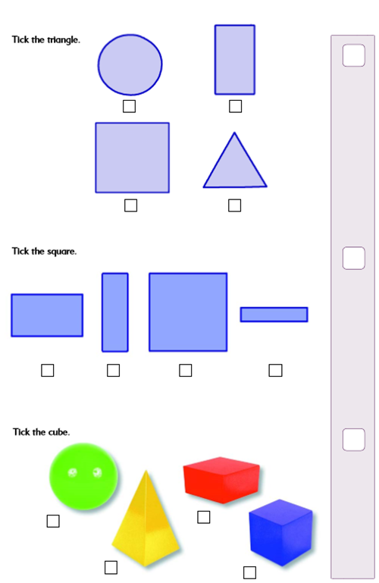
Q. 7
Bicycle

Slide 16
A. 7
Bicycle

Slide 17
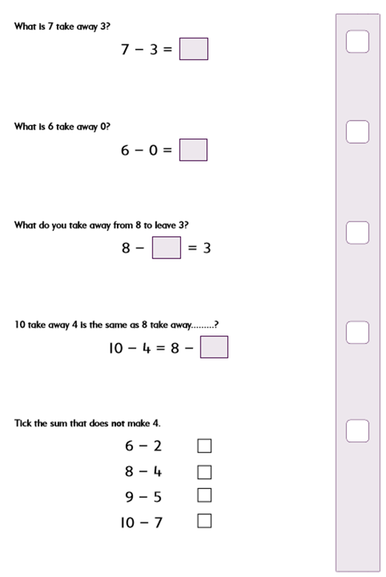
Q. 8

Slide 18
A. 8
7 - 3 = 4
6 - 0 = 6
8 - 5 = 3
10 - 4 = 6 = 8 - 2
10 - 7 = 3 ( Not 4)

Slide 19
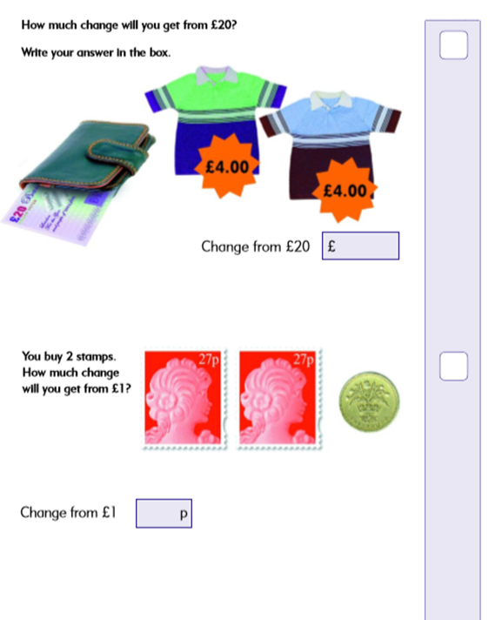
E 2.
Q. 9

Slide 20
E 2.
A. 9
Total amount of the 2 things = £4+ £4
= £ 8
Change from £20 = £20 - £8
= £ 12.
100 p
- 54 p
46 p
Total cost of the two stamps = 27p + 27p
= 54 p
Change from £1 = £1 - 54p
= 100 p - 54 p = 46 p

Slide 21
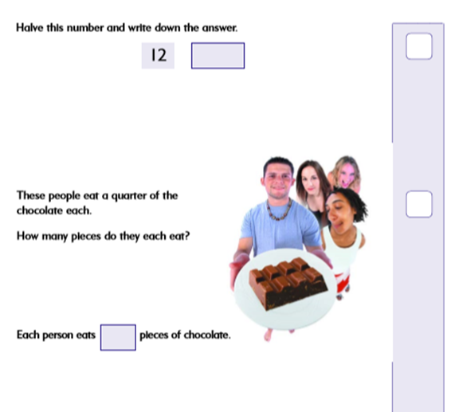
Q. 10

Slide 22
Halve means divide the given number by 2 :
12 ➗ 2 = 6
To find a Quarter , divide by 4 :
8 ➗ 4 = 2
A. 10

Slide 23
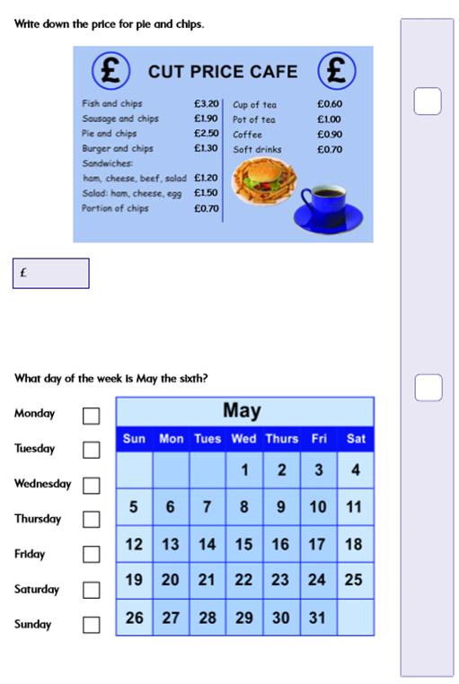
Q. 11
2 . 50

Slide 24
A. 11
2 . 50

Slide 25
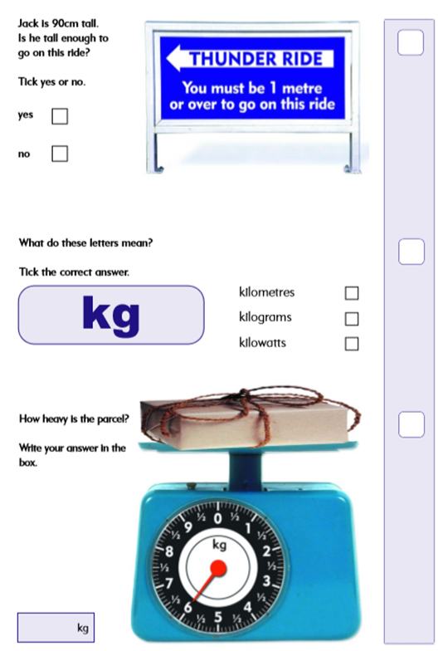
Q. 12
6

Slide 26
A. 12
6

Slide 27
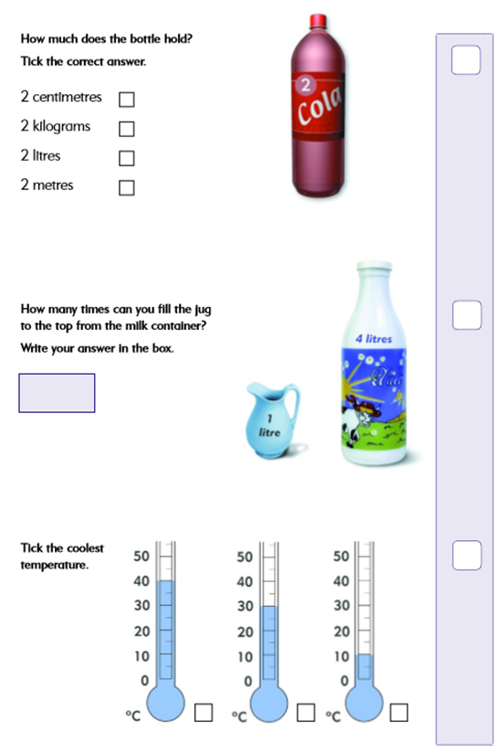
Q. 13
4

Slide 28
A. 13
4

Slide 29
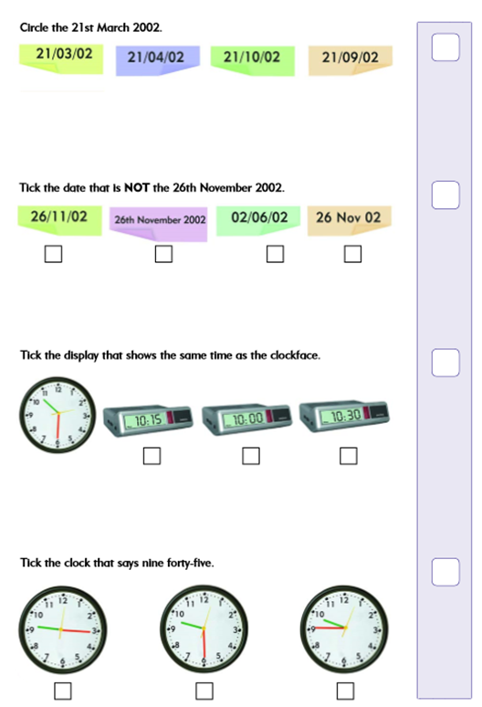
Q. 14

Slide 30
A. 14

Slide 31
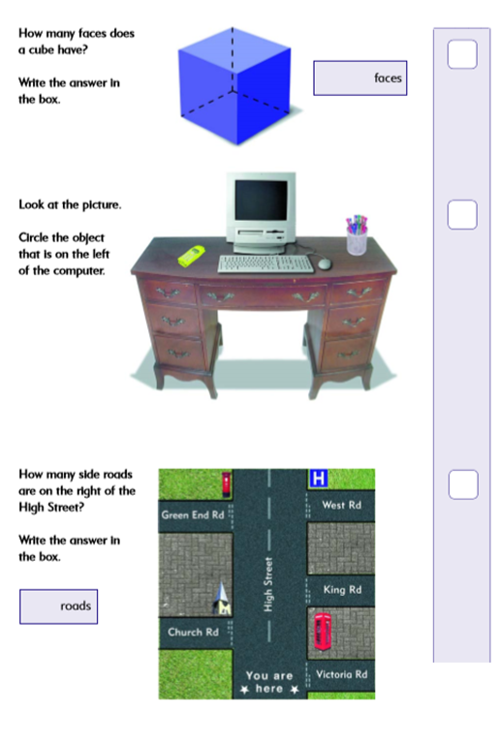
Q. 15
6
3

Slide 32
A. 15
6
3

Slide 33
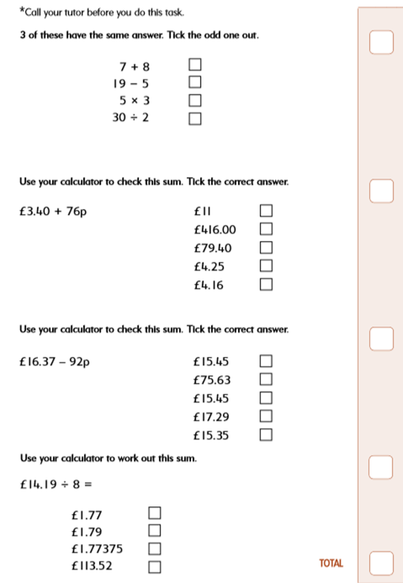
# E3 #
Q. 16

Slide 34
# E3 #
A. 16
$$÷$$

Slide 35
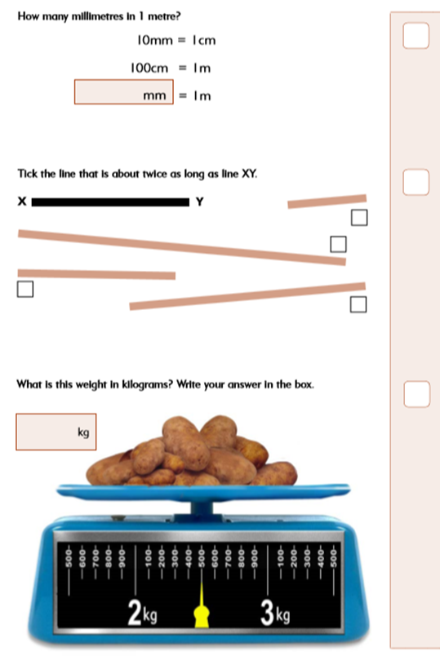
Q. 17
1000
2.5

Slide 36
A. 17
1000
2.5

Slide 37
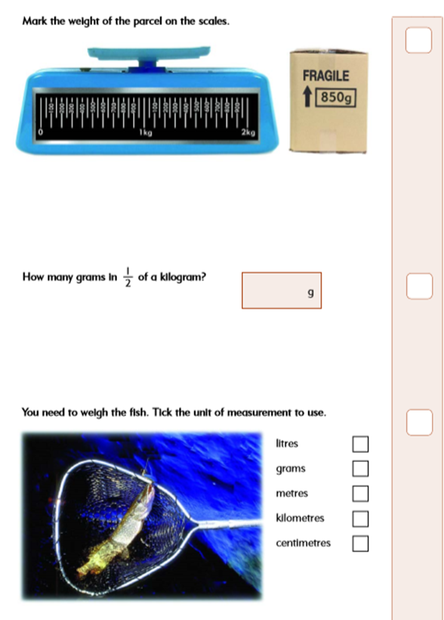
Q. 18
850 g
500

Slide 38
A. 18
850 g
500

Slide 39
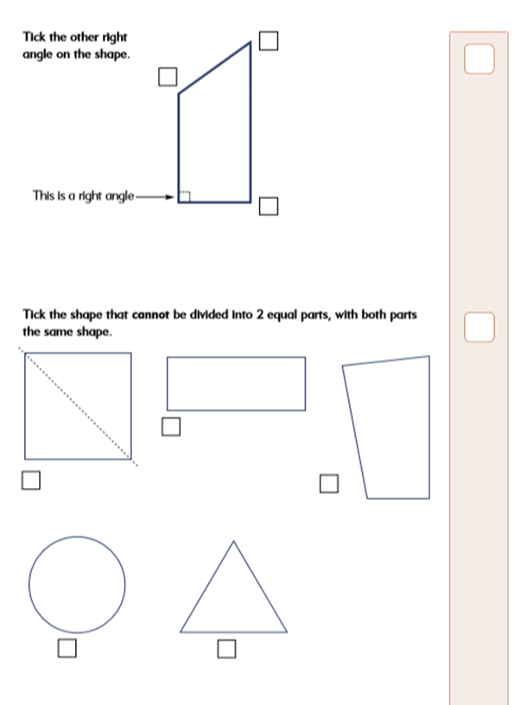
Q. 19

Slide 40
A. 19

Slide 41
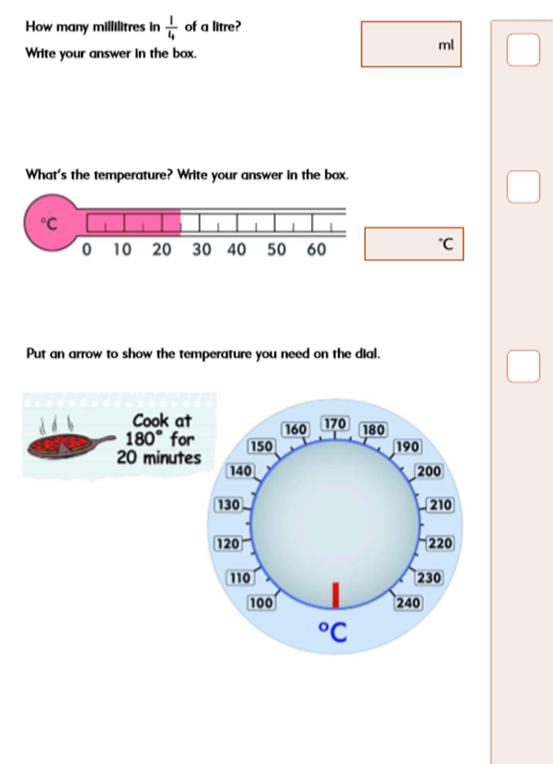
Q. 20
250
1000 / 4 = 250
25

Slide 42
250
A. 20
1000 / 4 = 250
25

Slide 43
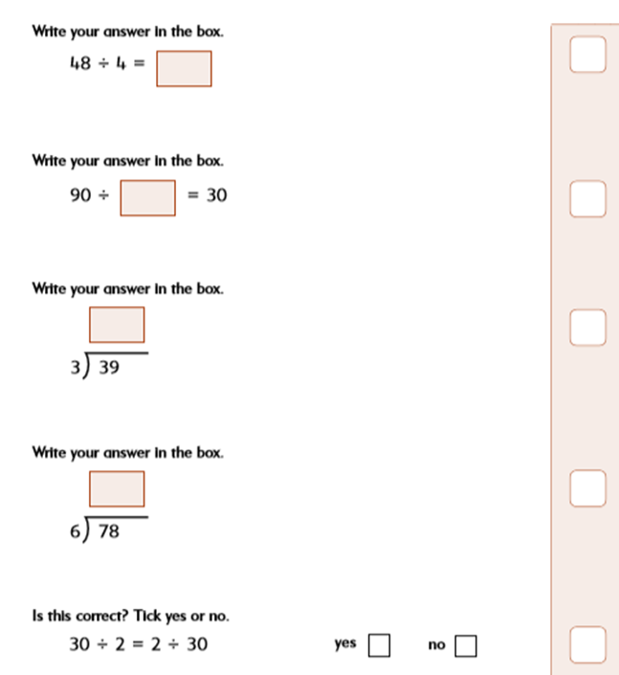
Q. 21
12
3
13
13

Slide 44
A. 21
12
3
13
13

Slide 45
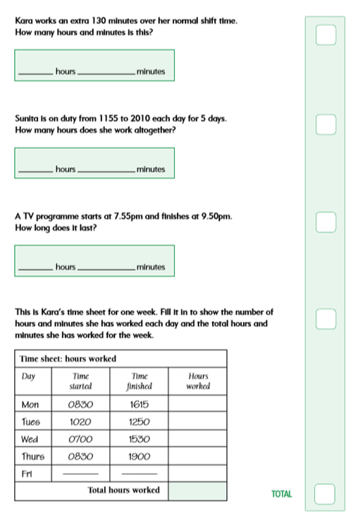
# L 1 #
Q. 22
2
10
41
15
1
55

Slide 46
# L 1 #
130 = 60+60+10
= 2 hr 10 min.
A. 22
2
10
20:10
- 11:55
19 hr : 70 min
-11 hr : 55 min
41
15
(8 hr : 15 min)
X 5 = 40 hr : 15 x 5 min
1
55
9 : 50
- 7: 55
= 40 hr : 75 min
= 41 hr : 15 min
8 : 110 min
- 7 : 55
1 hr: 55 min
7 hr:45 min
2 hr:30 min
8 hr:30 min
10 hr:30 min
27 hr: 135 min = 29 hr : 15 min
29 hr:15 min

Slide 47
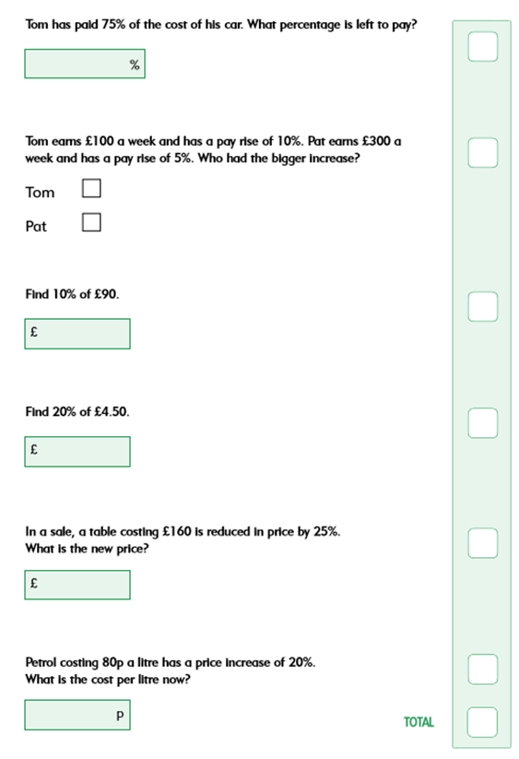
Q. 23
25
0.90
120
96

Slide 48
A. 23
25
100 - 75% = 25 %
10 % of 100 = £10
Pat: 5 % of 300
= 5 x 3 = £15
10% of 90
= 10 x 0.9 = £9
9
20% x 4.50
2x 10% x 4.50
= 10% x £ 9
= £ 0.90
0.90
100 -25 % = 75%
75% x 160 = £ 120
120
100% +20% = 120%
80p X 120 % = 80 X 1.20
= 8 x12 = 96 p
96

Slide 49
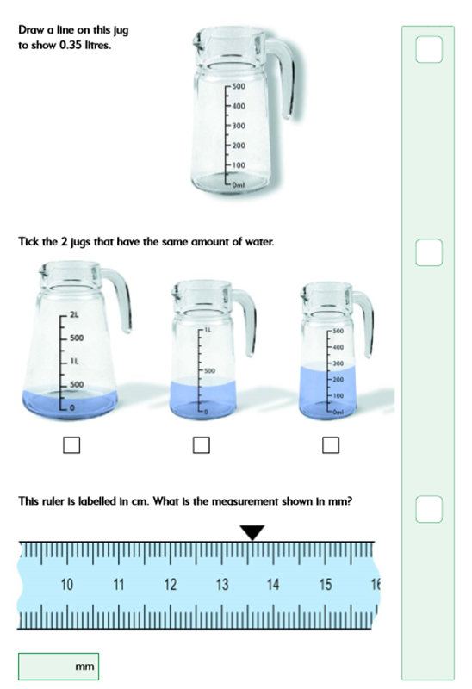
Q. 24

Slide 50
A. 24
0.35 Litres = 350 ml
13.6 cm = 136 mm
136
96

Slide 51
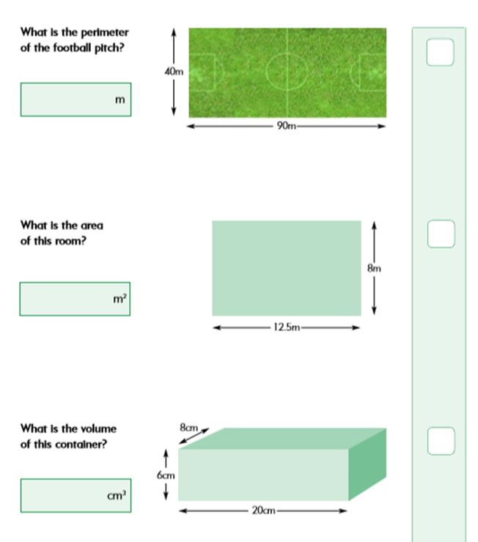
Q. 25
260
B
100
L
B
H
L

Slide 52
A. 25
40 + 90 + 40 + 90
= 130 + 130 = 260 m
260
Area = L x B
= 12.5 x 8
= 12.5 x 2 x 4
= 25 x 4 = 100 m^2
B
100
L
13.6 cm = 136 mm
B
Volume = L x B x H
= 20 x 8 x 6
=160 x 6
= 600 + 360
= 960 cm^3
H
960
136
L
96

Slide 53
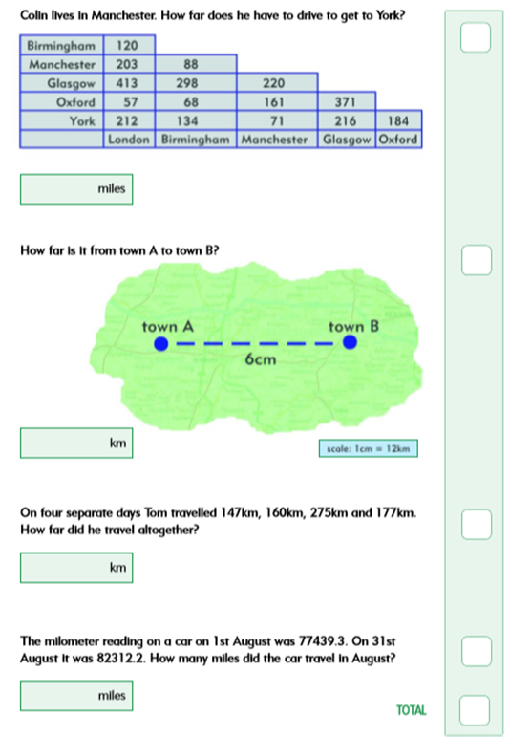
Q. 26
71
72
759
13.6 cm = 136 mm
4 872 . 9
136
96

Slide 54
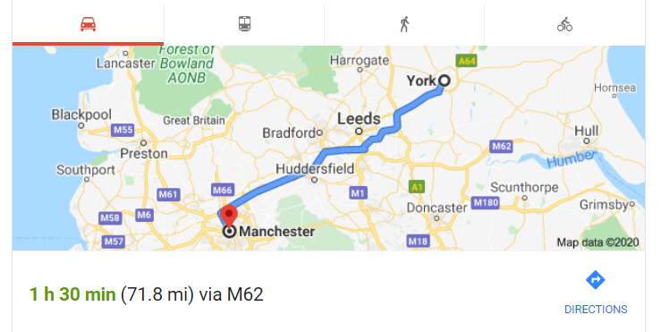
A. 26
71
You must show the necessary and possible Working to justify your answers, please in all problems !
6 cm x 12 km / cm
= 60 + 12 = 72 km
72
2 1
147
160
275
+ 177
759
759
13.6 cm = 136 mm
82 312 . 2
- 77 439 . 3
4 872 . 9
4 872 . 9
136
96

Slide 55
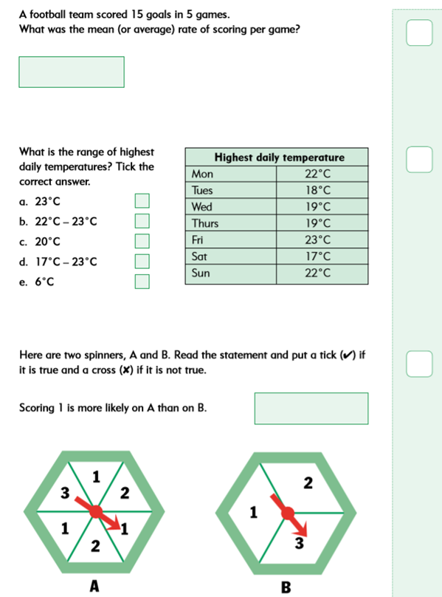
Q. 27
3

Slide 56
A. 27
15 / 5 = 3 goals / game
3
Range = Maximum -Minimum
= 23 - 17 = 6 Deg. C
True .
Probability of 1 in A =
3 /6 = ½ = 0.50
Probability of 1 in B =
1 / 3 = 0.33 < 0.50
B < A

Slide 57
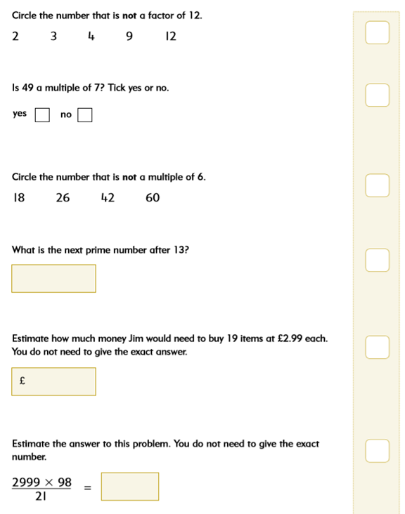
# L 2 #
Q. 28
17
60

Slide 58
# L 2 #
A. 28
Estimation is with rounded off numbers:
19 x £2.99 approximately equal to
20 x £ 3 = £ 60
17
60
3 000 x 10 0
2 0
= 3 000 x 5
= 15 000
15 000
( Approximately )

Slide 59
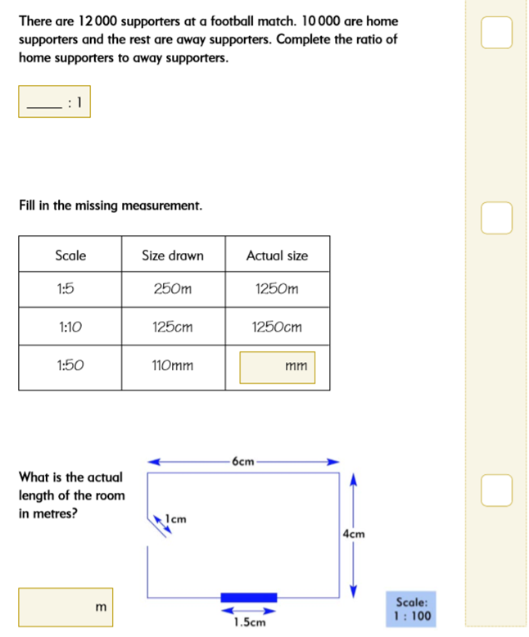
Q. 29
5

Slide 60
A. 29
{ H / ( 1 + H ) } X 12 000
= 10 000
H X 12 000 =10000 ( 1 + H)
12000 H = 10000 + 10000 H
12000 H - 10000 H = 10000
2000 H = 10 000
H = 10 000 / 2 000
= 5
H : 1 = 5 : 1
5
5 500
5 0 X 11 0 = 5 5 00
6 cm X 100 = 600 cm
= 6 m
6

Slide 61
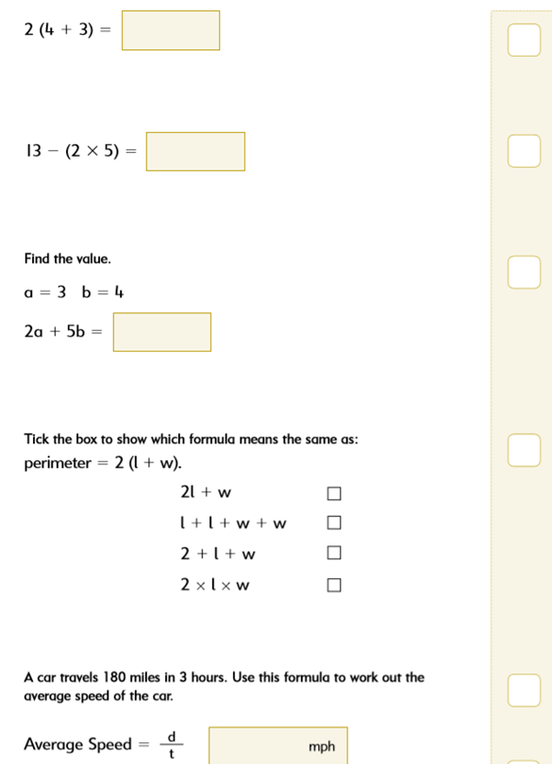
Q. 30
3
26

Slide 62
14
2( 4+3) = 2.(7) = 2x7 = 14
A. 30
3
13- (10) = 13-10 = 3
2 x( 3) + 5. (4) = 6 + 20
= 26
26
2 ( l + w ) = 2 l + 2 w
= l + l + w + w
180 miles 3 hours
= 60 miles / hr = 60 mph
60

Slide 63
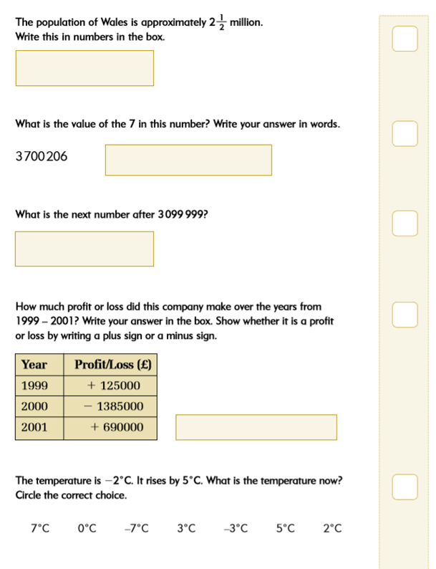
Q. 31
2 500 000
700 000
3 100 000
- 570 000 ( Loss )

Slide 64
2 ½ x 1 000 000
= 2 000 000 + ½ x 1 000 000
= 2 000 000 + 500 000
= 2 500 000
A. 31
2 500 000
700 000
3 099 999
1
3 100 000
3 100 000
+125 000
+ 690 000 = + 815 000
- 1 385 000
+ 815 000
- 570 000
- 570 000 ( Loss )
- 2 + 5 = +3 Deg.C

Slide 65
Total Marks Question-wise,
totalling to 100 :
11
12
13
14
15
16
17
18
19
20
21
22
23
24
25
26
27
28
29
30
31
1
2
3
4
5
6
7
8
9
10

Slide 66
Thank you so much dear student for your committed hardwork and practice:
Total marks obtained by you = /
100 =
%
Hence , your current Maths Level is : E0 / E1 / E2 / E3 / L1 / L2 (GCSE-Fdn)
E0 ⇒ Pre Primary ⇒ KS0 [ 0 - 5% ]
E1 ⇒ Primary ⇒ KS1 [ 6 - 20%]
E2 ⇒ Primary + ⇒ KS1 to KS2 [21 - 40 % ]
E3 ⇒ Primary ++ ⇒ KS2+ [41 - 65 % ]
L1 ⇒ SECONDARY ⇒ KS3 [66 - 85 % ]
L2 ⇒ SECONDARY + ⇒ KS4 [86 - 100%]

